Slide 1
Static Timing Analysis
Sci.D.Professor Vazgen Melikyan
Synopsys Armenia Educational Department

Slide 2
CONFIDENTIAL INFORMATION
The information contained in this presentation is the confidential and proprietary information of Synopsys. You are not permitted to disseminate or use any of the information provided to you in this presentation outside of Synopsys without prior written authorization.
IMPORTANT NOTICE
In the event information in this presentation reflects Synopsys’ future plans, such plans are as of the date of this presentation and are subject to change. Synopsys is not obligated to update this presentation or develop the products with the features and functionality discussed in this presentation. Additionally, Synopsys’ services and products may only be offered and purchased pursuant to an authorized quote and purchase order or a mutually agreed upon written contract with Synopsys.

Slide 3
Course Overview
STA Concepts
2 lectures
Delay Modeling
2 lectures
Interconnect Parasitics
2 lectures
Delay Calculation
2 lectures
Configuring the STA Environment
3 lectures
Timing Checks
1 lecture
Crosstalk and Noise
2 lectures
Statistical Static Timing Analysis
2 lectures

Slide 4
Statistical Static Timing Analysis

Slide 5

Variability
On-chip variation (OCV)
Device
Interconnect
Operating conditions
Temperature
Voltage
$⋯$

Slide 6

Process Variation Sources and Types
Types
Systematic
Random
Sources
Lithography induced Variations
Etch induced Variations
CMP induced Variations
Random Dopant Fluctuations
Interconnect Variations
Non-Linear Resistance
Metal Mismatch
$⋯$

Slide 7
Modeling Variation
Violations
total
Systematic
Random
e.g. lithography
e.g. doping
random
Deterministic models
=> predict variations
Deterministic models don’t exist. Known min-max range or distribution

Slide 8
Process Corners
“slow” corner; max L, max V_{T}
Threshold Voltage V_{T}
typical
actual distribution
(darker = more likely)
“fast” corner; min L, min V_{T}
Channel Length L

Slide 9
Conventional Corner-Based Analysis
Parasitic Extraction Tool
Corner Libraries
Corner parasitics
Timing Analysis Tool
Derating
Constraints
Slack timing report
3..6ns
1..2ns
1..2ns
1..2ns
Notes:
9

Slide 10
Variation-Aware Timing Analysis Flow
Statistical Parasitic Extraction Tool
Variation Libraries
Statistical parasitics
Process Parameter Distribution
Statistical Static Timing Analysis Tool
Constraints
Slack timing report
Worst case (min/max) slack: 0.8ns
97% passing slack: 1.1ns
0.8
1.1
Path slack
Notes:
10

Slide 11
Benefits of Variation-Aware Analysis
Margin Control
Design Robustness
Avoid over and under-design
Greater trade-off for area or power
Reduces need for multi-corner analysis
Improve parametric yield
Identify and fix areas of design susceptible to variation
Slack
Design slack (robustness)
Traditional Corner Slack
Variation-aware slack
Worst-case
0
failing
0
Notes:
11

Slide 12
Everything Statistical
Gate delays are statistical
Signal arrival times are statistical
Want distribution of delay at output
Gates and signals are correlated
Correlations are both local and global

Slide 13
Statistical Timing Analysis
Monte-Carlo
Statistical Static Timing Analysis

Slide 14
Monte-Carlo Method
Random sampling of each probability distribution within the model
Produces 1000's or even 10,000's of scenarios
Iterations or trials
Each probability distribution is sampled in a manner that reproduces the distribution's shape
Distribution of the values calculated for the model outcome therefore reflects the probability of the values that could occur

Slide 15
Introduction to Statistical Static Timing Analysis
SSTA
=
STA
+
Statistical models
Gate delay
Interconnect parasitics
Operating conditions
Power supply
Temperature
.
.
.

Slide 16
Probability
Probability Density
Probability Density
Gate Delay
Gate Delaay
Probability Density Function (PDF)
Probability that gate delay has value x
Comulative Probability Distribution Function (PDF)
Probability that gate delay is lower than x

Slide 17
Distribution of Propagation
C
0
2
4
6

Slide 18
Statistical ADD Operation
Distribution density
Gate
Interconnect
sum(f₁, f₂)
f
f₁
f₂
Average m₁, 3σ=s₁
Average m₂, 3σ=s₂
Delay PDF of path is statistical sum of f₁ and f₂
STA:
SSTA:

Slide 19
Statistical MAX Operation
f₁
Distribution density
max(d₁, d₂)
f₁
d₁
f
f₂
f₂
3σ
d₂
Delay PDF at output pin is calculated as upper bound of statistical max of d₁ and d₂

Slide 20
Statistical MAX Operation (2)
Highly correlated, overlapping,
different sigmas
Non-overlapping
P₁
P₂
P₂
P₁
μ₁
μ₂
x₁ μ₁ x₂ μ₂ y₂ y₁
MAX is trivial
MAX is complicated

Slide 21
SSTA Approaches
Path-Based SSTA
Block-Based SSTA
Path delay PDFs
Circuit delay PDF
V1
V1
V2
V2
S
E
S
E
V3
V3
V5
V5
V4
V4
Simultaneous analysis of all
paths from S to E
Individual analysis of paths from S to E

Slide 22
Spatial Correlations
(0,1)
(1,2)
(1,3)
(1,1)
(1,4)
(2,6)
(2,5)
(2,8)
(2,2)
(2,7)
(2,14)
(2,4)
(2,13)
(2,12)
(2,1)
(2,10)
(2,15)
(2,3)
(2,12)
(2,9)
(2,11)

Slide 23
Spatial Correlations Should be Considered
SSTA unaware of Spatial correlations
0.12
0.1
0.08
0.04
0.02
0
Probability
Monte-Carlo considering Spatial correlations
3 3.2 3.4 3.6 4 4.2 4.4 4.6 4.8 5
Delay (ns)

Slide 24
Considering Spatial Correlations

Slide 25
Additional Data for SSTA
Library with Gaussian distributions if gate delays
Gate-Netlist
SSTA

Slide 26
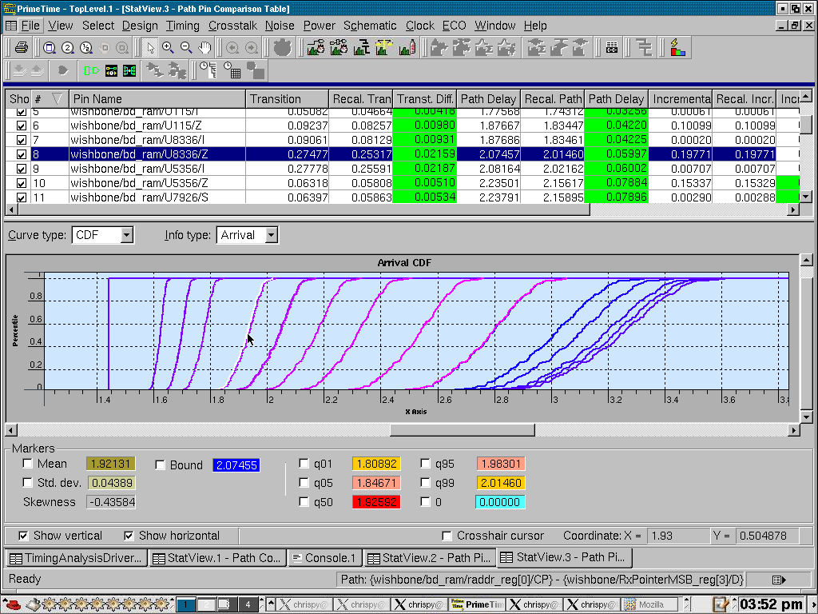
SSTA Tool Inputs and Outputs
Sensitivity-based
Extraction
SPEF w/ sensitivity
Netlist
Variation Reports
PrimeTime VX
probability
Device and interconnect
Process Parameter
Variation Distributions
Characterization
Variation-aware
library
Statistical device Models

